Slide 1




Building Reusable Learning Content and Tools
Dr. Charles Severance
University of Michigan School of Information
www.tsugi.org www.koseu.org
https://www.slideshare.net/csev

Slide 2
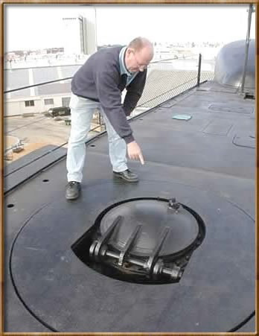

IMS Learning Tools Interoperability

Slide 3

TL;DR
Empower Indie publishers
Democratize MOOCs
Democratize LORs
Disaggregate LMS

Slide 4



LTI
CC/LTI/CI

Slide 5

CC/LTI/CI
CC/LTI/CI

Slide 6
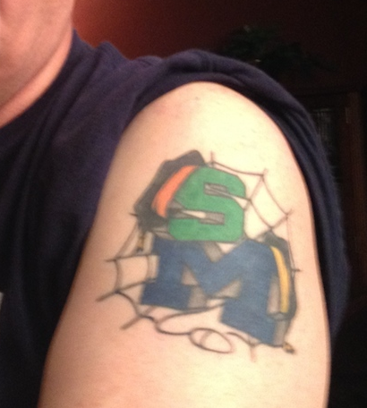
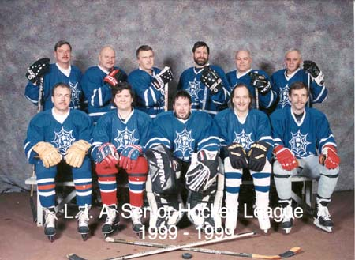

Slide 7
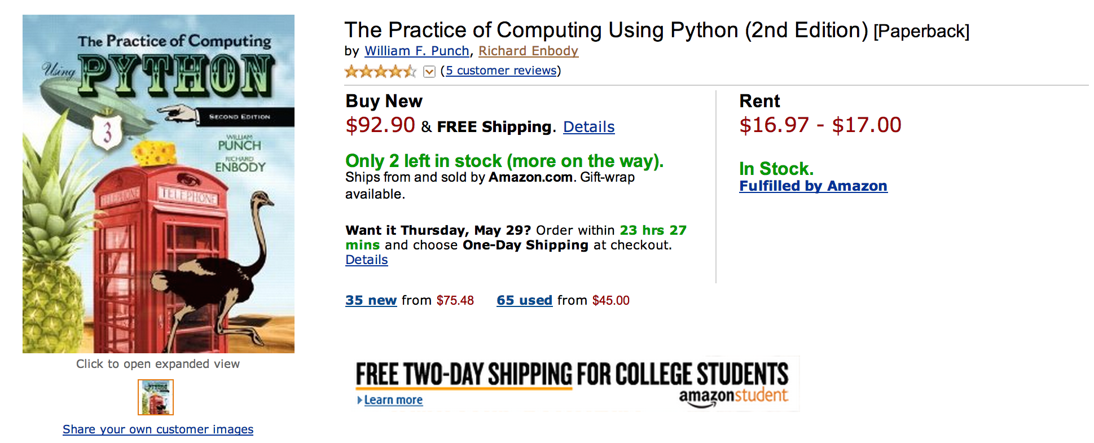
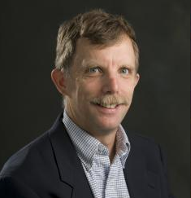
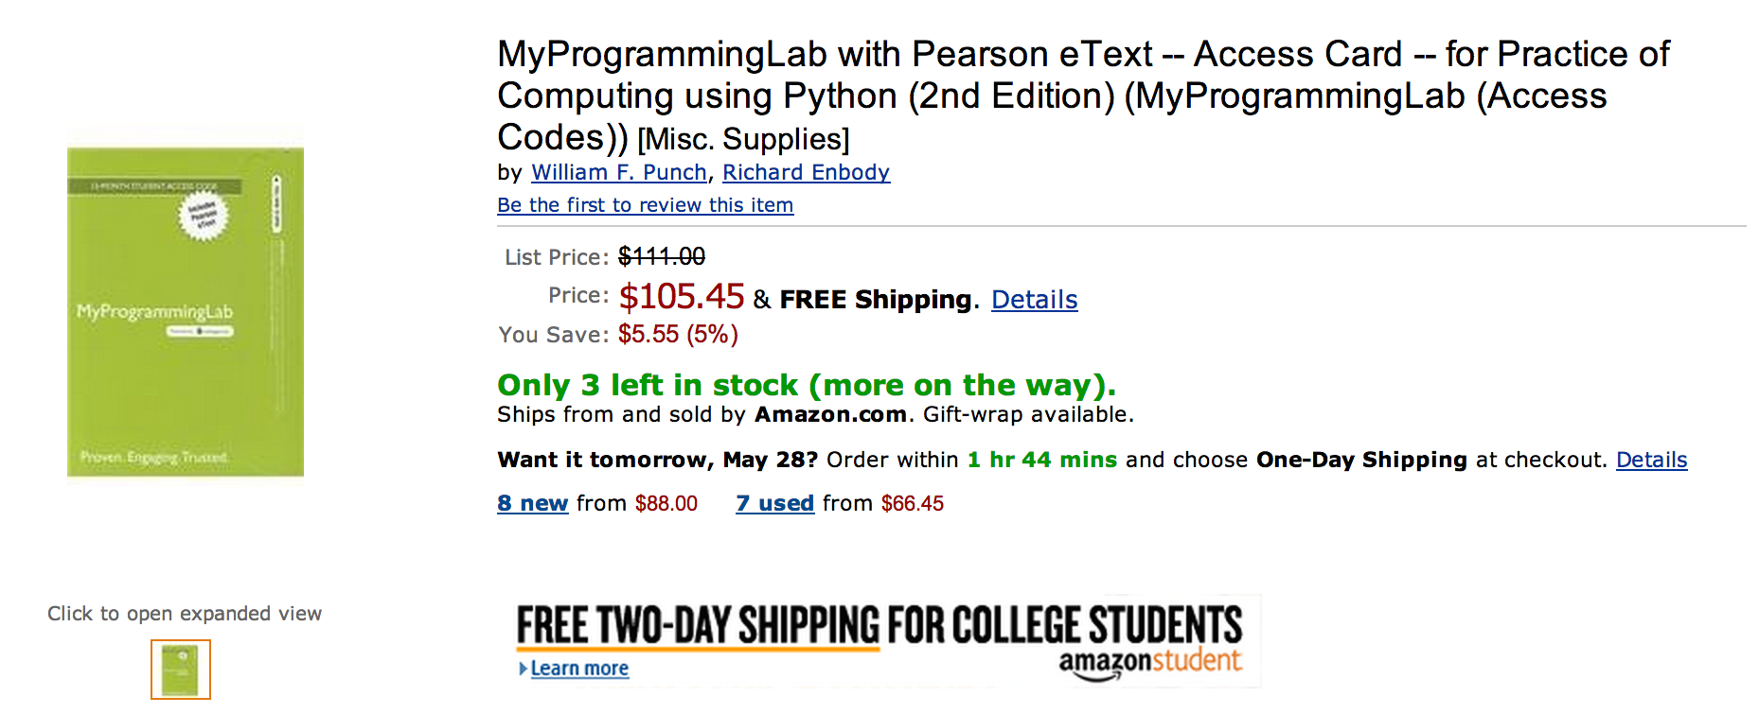

Slide 8
What does $198.35 get you?
Book
Automatic Homework Grading Software
Learning Management System Integration
Instructor Materials
Slides / Solutions Manual / Exams / Course Copy
Instructor Training
Notes:
$65 from Pearson $130 Form bookstore

Slide 9

Teacher Prep
Book
Pearson Value
Proposition
$200
Marketing
Software

Slide 10
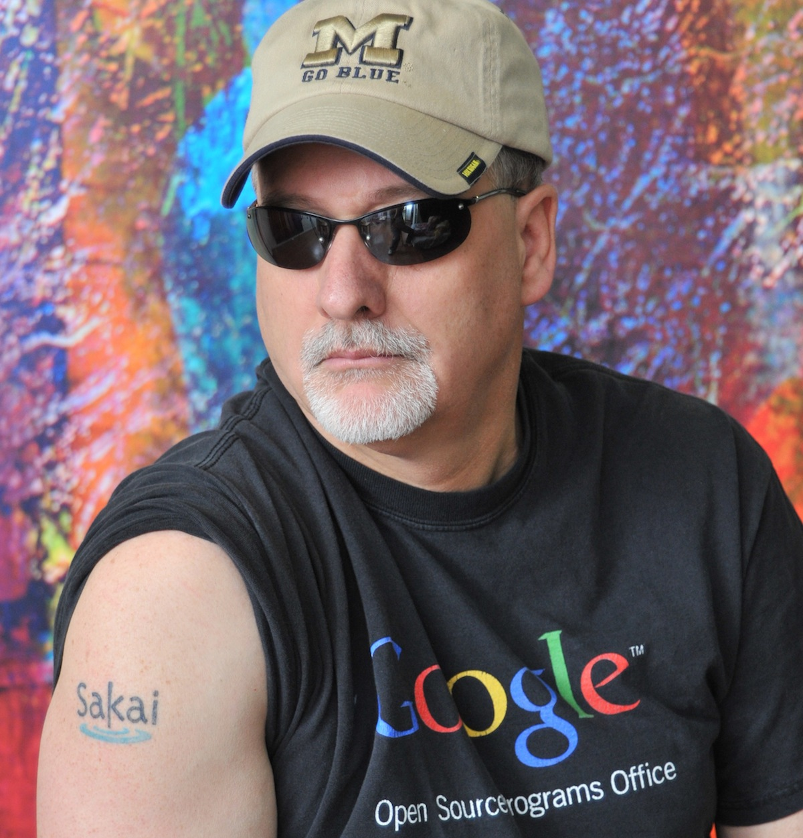
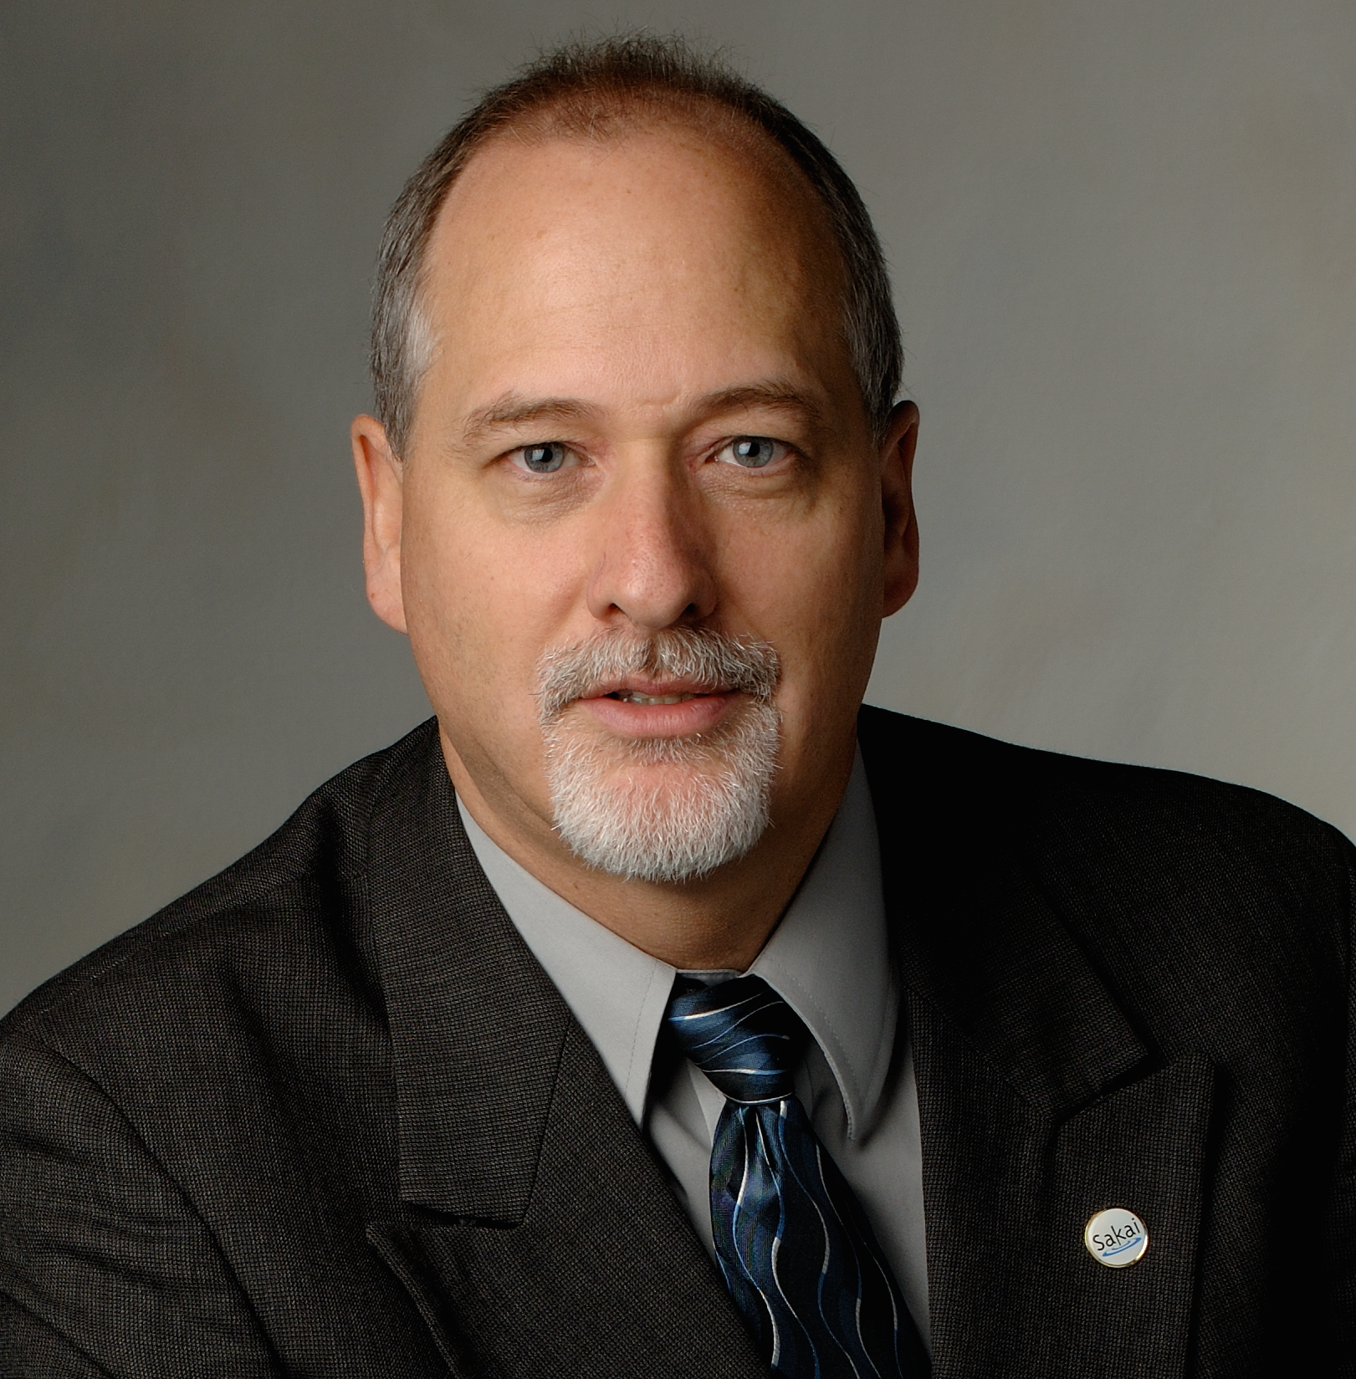



Slide 11

www.masteringphysics.com

Slide 12
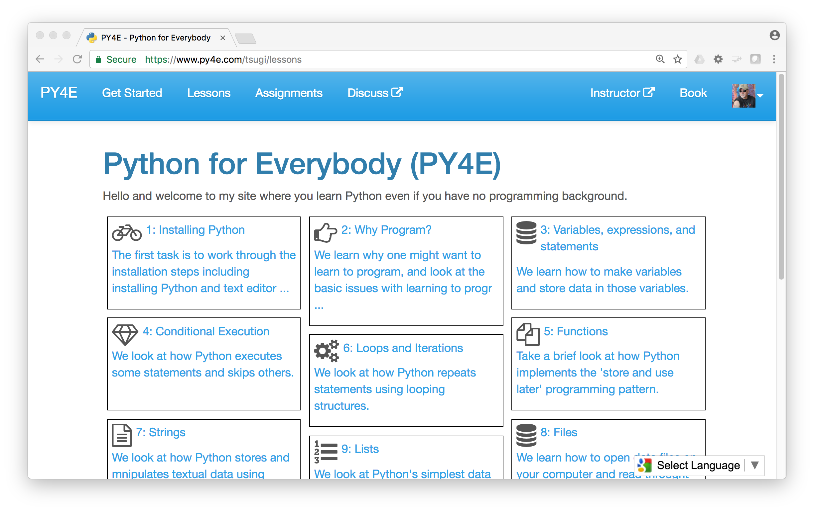
www.py4e.com (a.k.a. www.masteringpython.com)

Slide 13
The World's Simplest MOOC Platform
$ composer require --dev koseu/lib
koseu.php:
<?php
define('COOKIE_SESSION', true);
require_once "tsugi/config.php";
// Pull in the Koseu LMS (/lessons, /map, /badges ...)
$launch = \Tsugi\Core\LTIX::session_start();
$app = new \Koseu\Core\Application($launch);
$app->run();
https://github.com/tsugiproject/koseu-php

Slide 14
CONTENT ITEM®
CC®
LTI®
IMS CONTENT ITEM® FILLS THE GAPS AND MAKES CONNECTIONS BETWEEN IMS LEARNING TOOLS INTEROPERABILITY® AND IMS COMMON CARTRIDGE®.
LTI®, CC®, and Content Item® are trademarks of IMS Global Learning Consortium, Inc. (www.imsglobal.org)

Slide 15
CONTENT ITEM®
CC®
LTI®
FOR THE FIRST TIME IN THE HISTORY OF EDUCATIONAL TECHNOLOGY, YOU CAN MAKE AN APP STORE AND LEARNING OBJECT REPOSITORY WITHOUT PROPRIETATY EXTENSIONS.
LTI®, CC®, and Content Item® are trademarks of IMS Global Learning Consortium, Inc. (www.imsglobal.org)

Slide 16

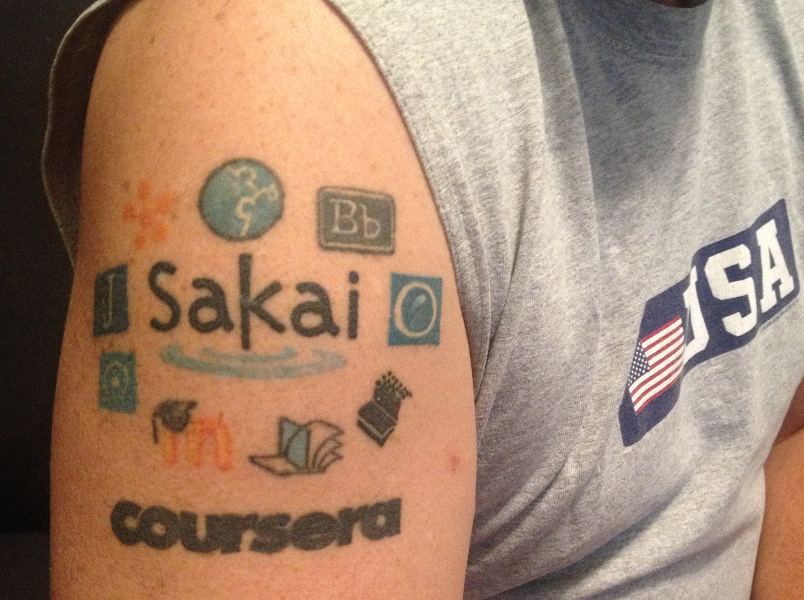
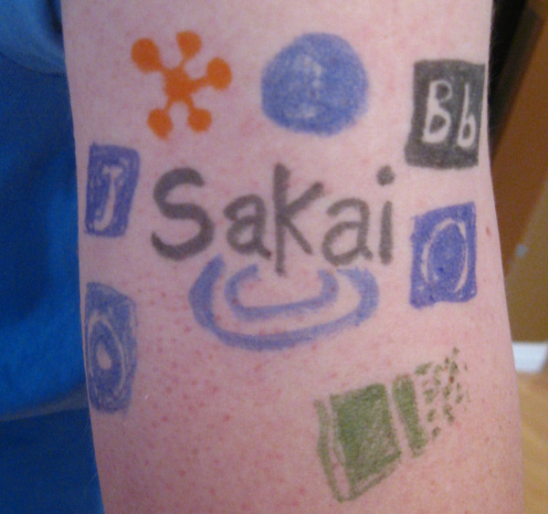
@drchuck
@whitmer
@brackenm

Slide 17
Topics
Educational App Store
API Libraries
"Lego Blocks"
Interoperability
New tools that *teach*
EdTech startups made easy
Training / Documentation
Enrich Open Educational Content
Seamless Content Integration and Reuse (LOR)
Stand-Alone MOOC platform
LMS based on Tsugi technology
koseu.org (코스)

Slide 18

CreateSpace
10
Pandoc
py4e.com
App Store (次)
OER Content (코스)
3K
github
1.2M
Coursera
Media
UM/Canvas
300
archive.org
Amazon
YouTube
ITunes
GooglePlay

Slide 19
Demo (time permitting)

Slide 20
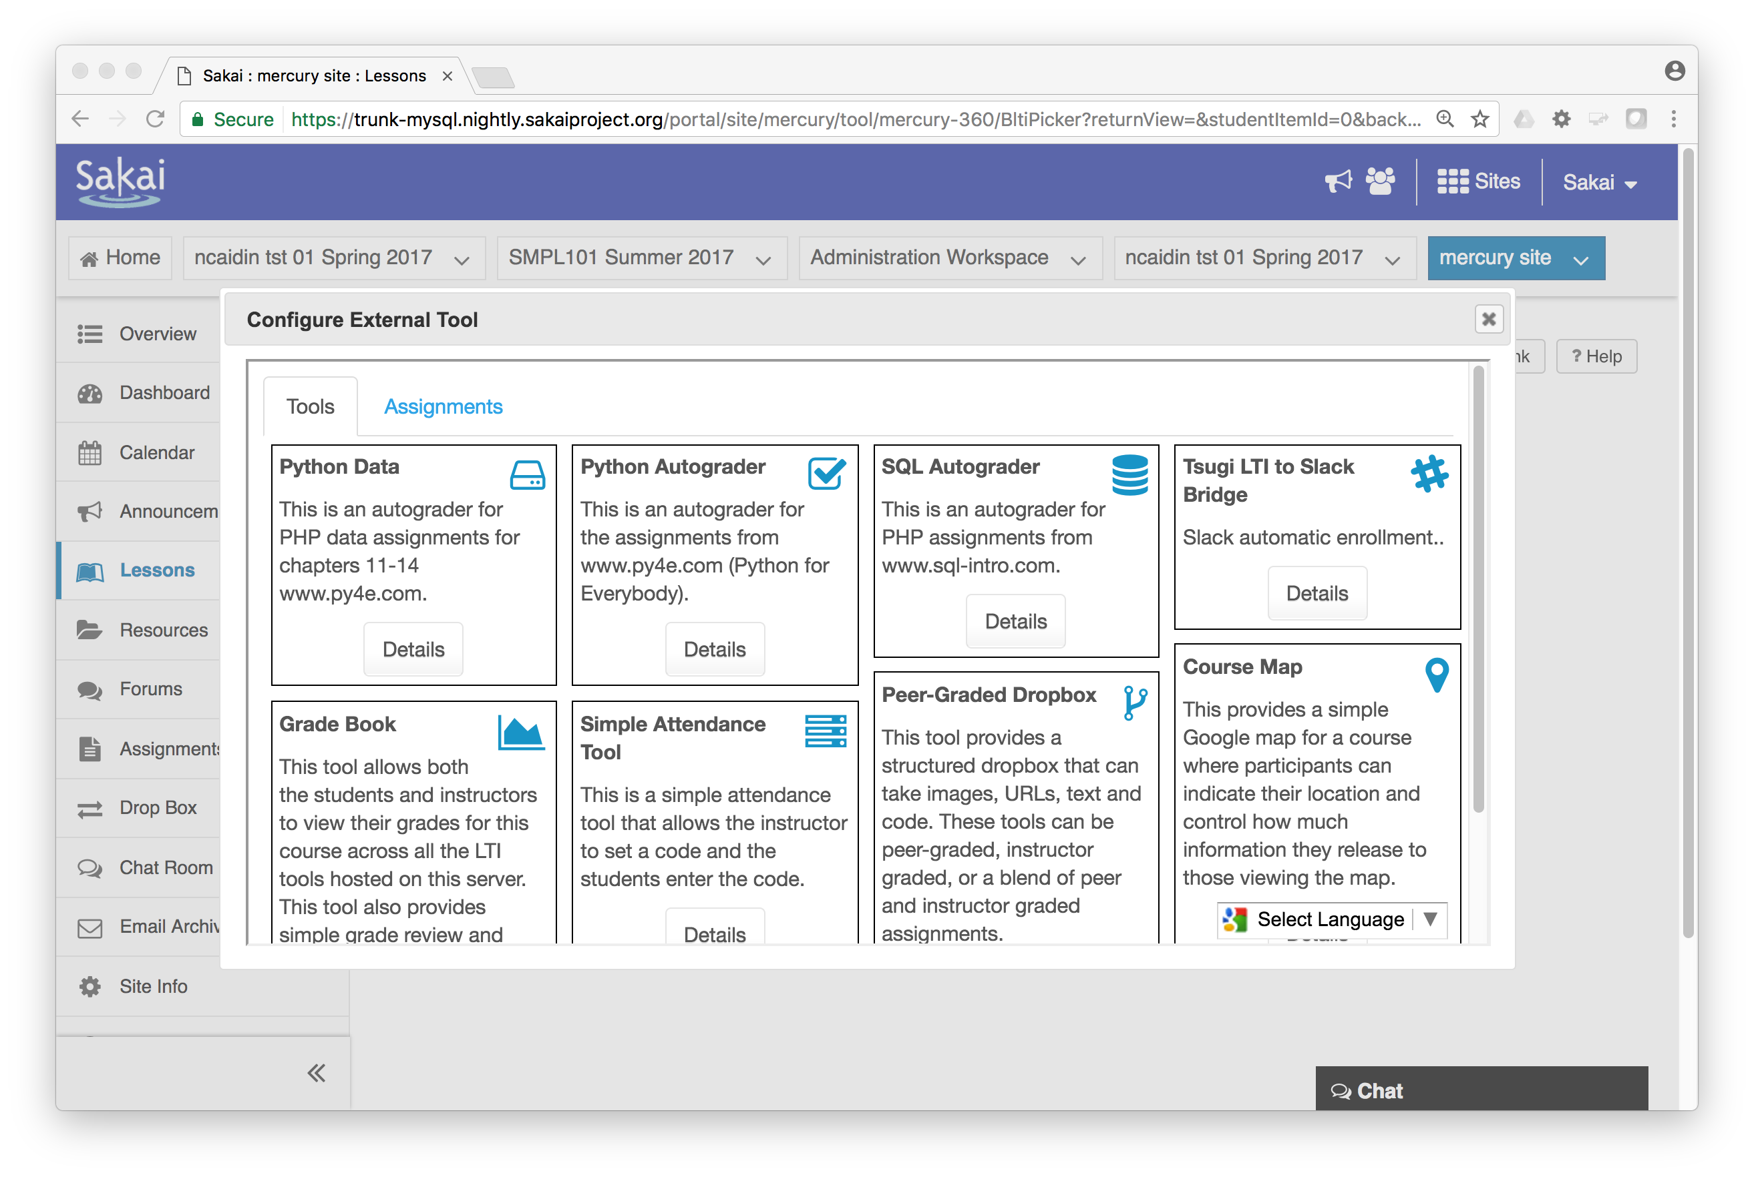

Slide 21
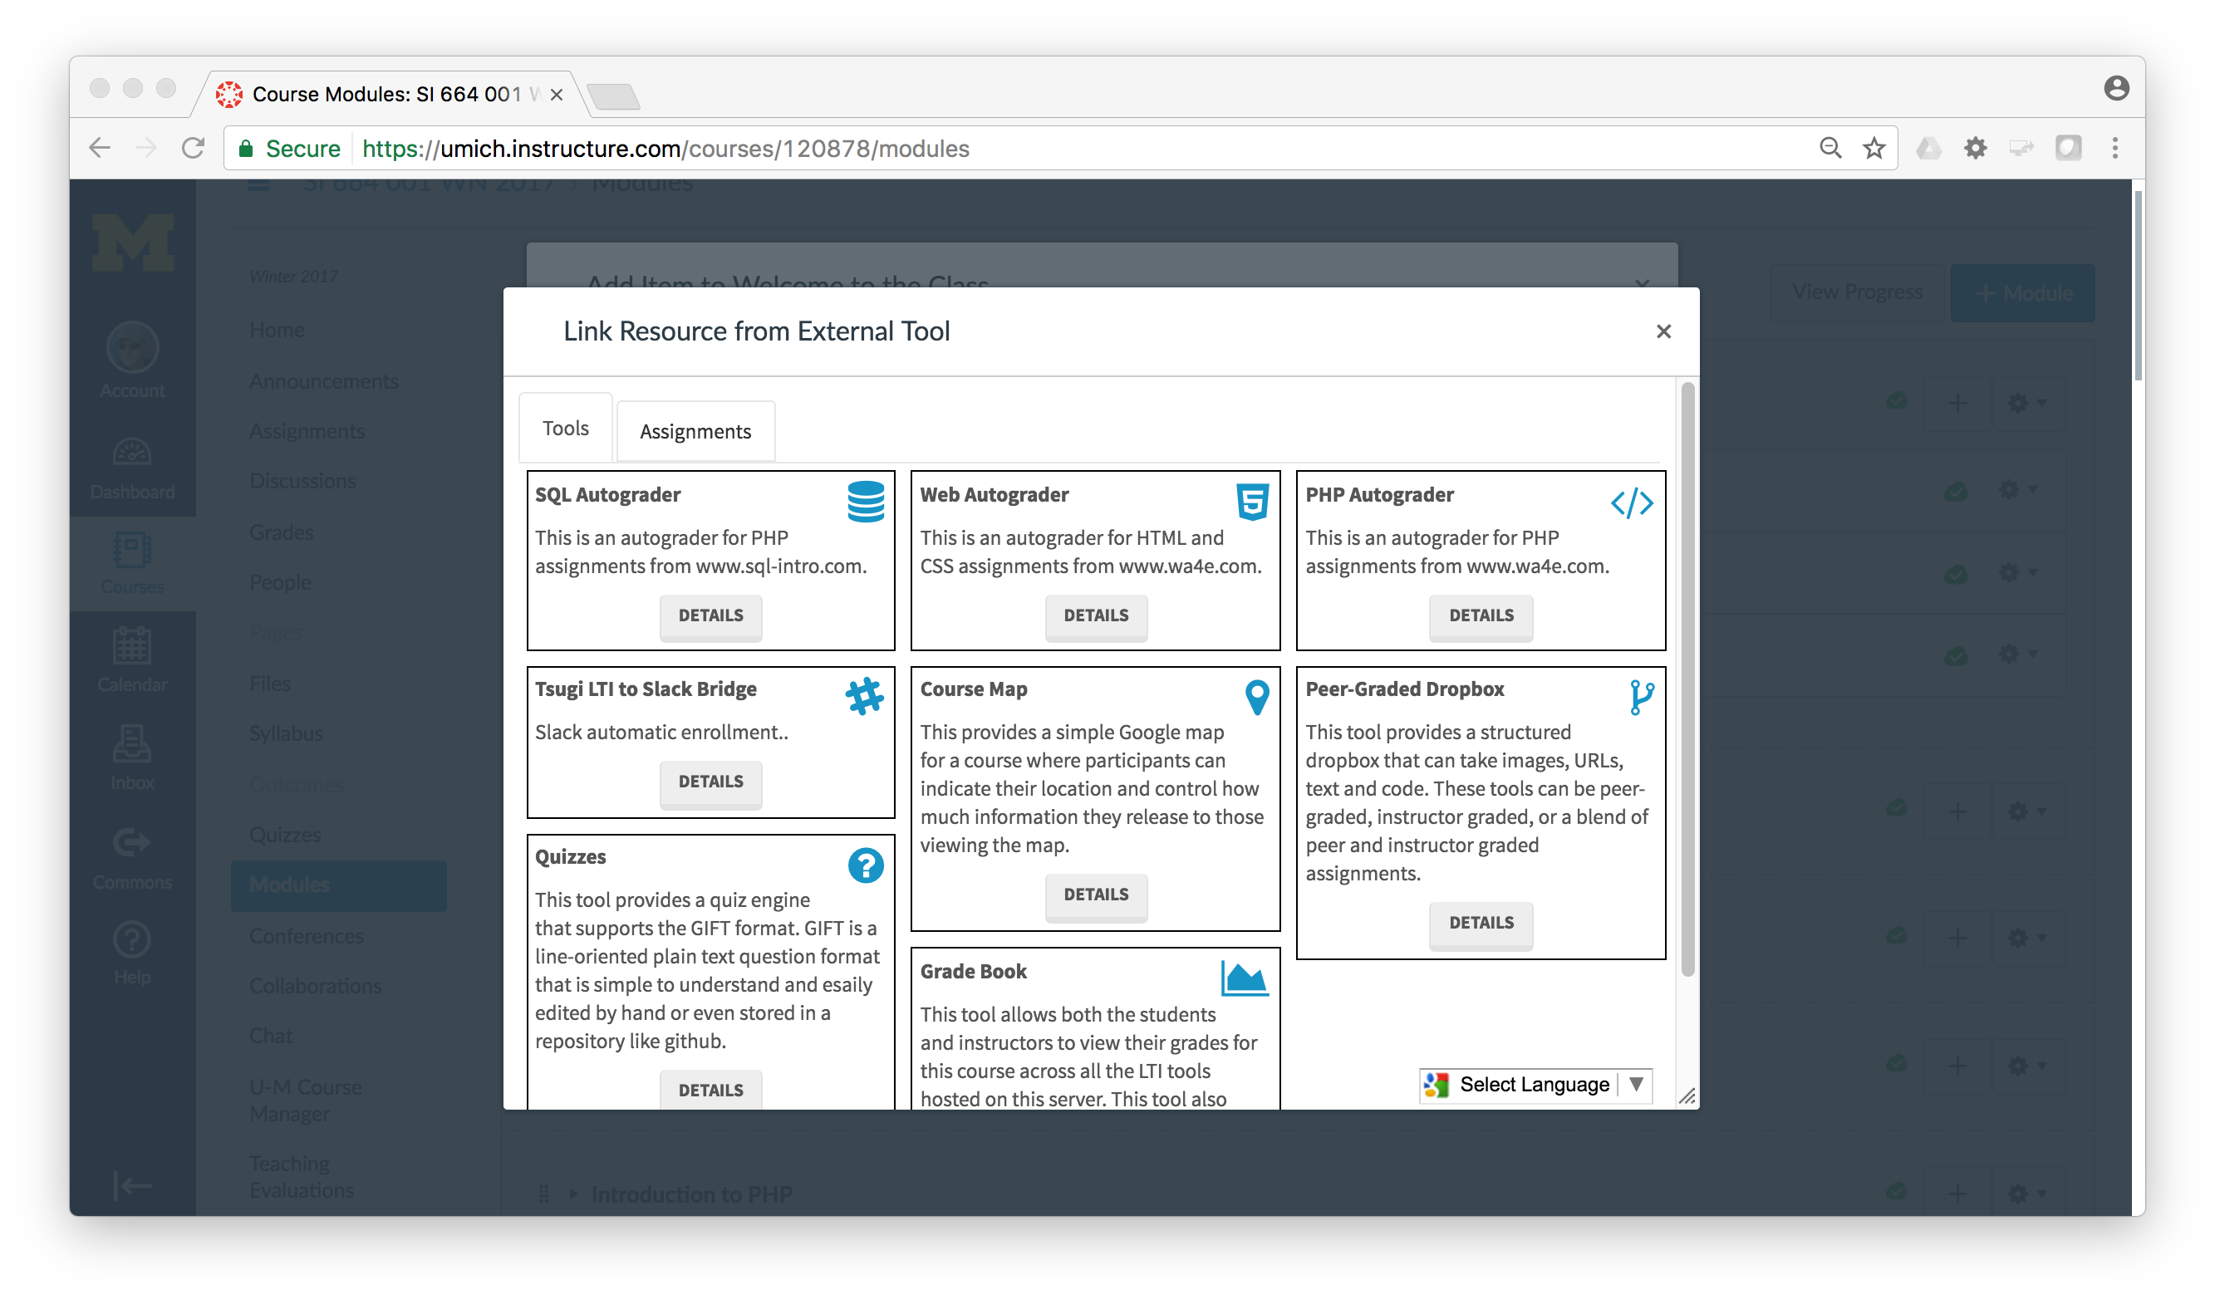

Slide 22
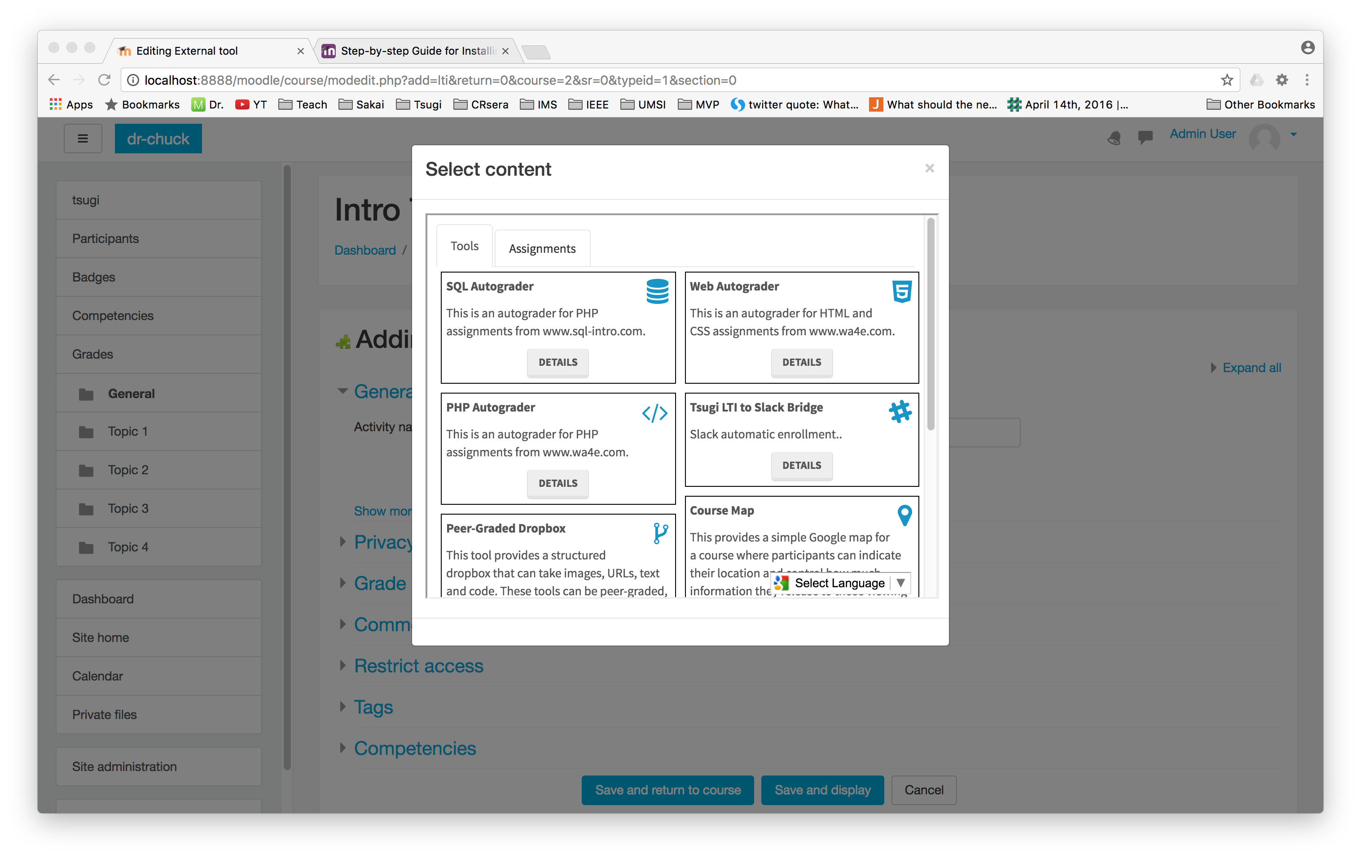

Slide 23
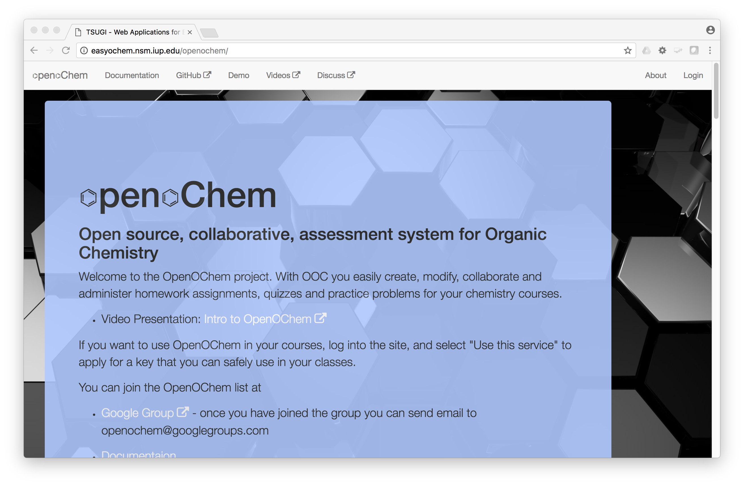
Carl LeBlond, Indiana University of Pennsylvania

Slide 24
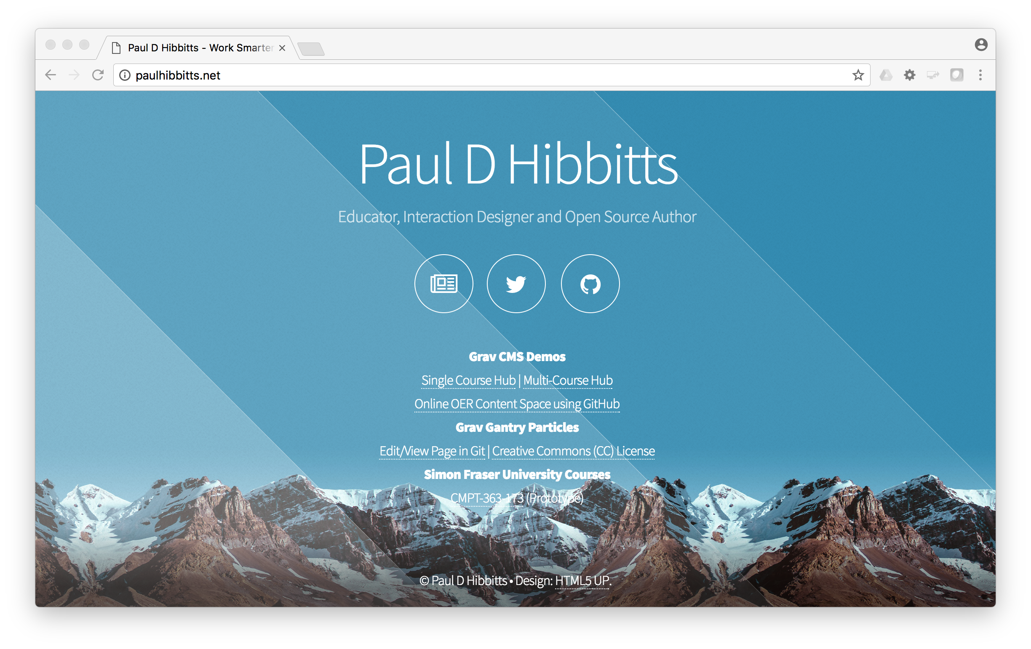

Slide 25
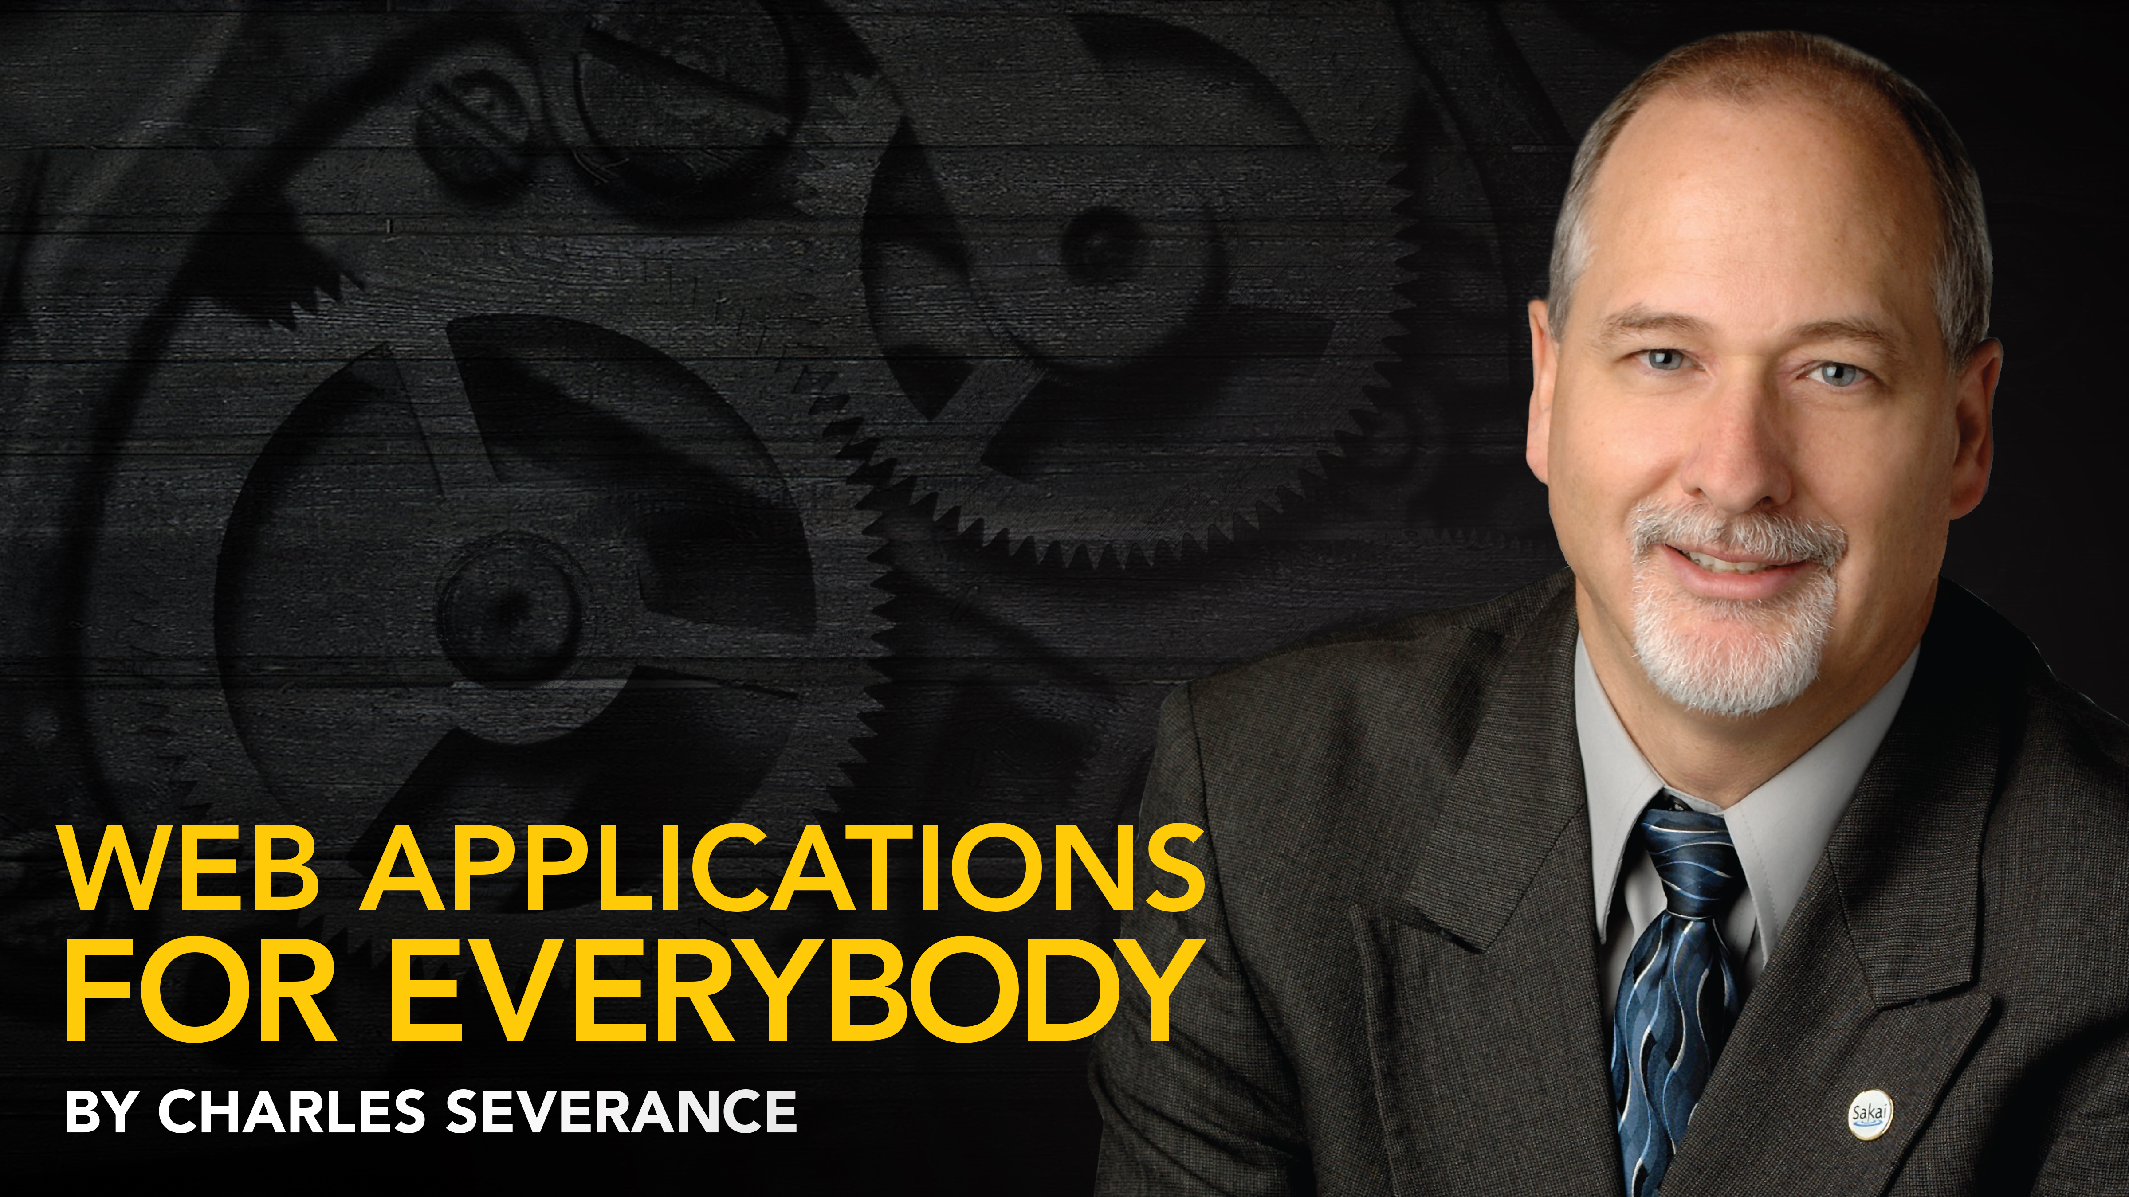
Any Questions? www.tsugi.org www.py4e.com www.wa4e.com

